Slide 1
Statistics for Linguists
2023-11-15/22
Introduction to basic inferential concepts

Slide 2
From last week
How to plot things
Some starting simulations
Frequency vs. probability distribution

Slide 3
For this week
Lots more simulations
Sample variance
Standard deviation
T statistic (and z statistic)
Probability distributions / functions
p values
Confidence intervals
What’s a linear model
ANOVA (comparing groups)

Slide 4
Preparation
You need to download two databases
Araonavowels
Chacobo forced task
You need to install the following packages
rlist()
tidyverse()
reshape()
Nhstplot()

Slide 5
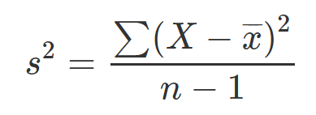
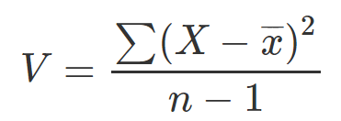
Sample variance

Slide 6
Sample variance
Variance

Slide 7
Sample variance
Sum over all cases of ...

Slide 8
Sample variance
Every value in the sample

Slide 9
Sample variance
minus the mean of the sample

Slide 10
Sample variance
divided by the sample

Slide 11
Variance
What happens to the variance if n increases?
What happens to the variance if values are more spread out?
What is the relationship between variance and the standard deviation?

Slide 12
Variance
What happens to the variance if n increases?
Variance decreases
What happens to the variance if values are more spread out?
Variance increases
What is the relationship between variance and the standard deviation?
The variance is the standard deviation squared.

Slide 13
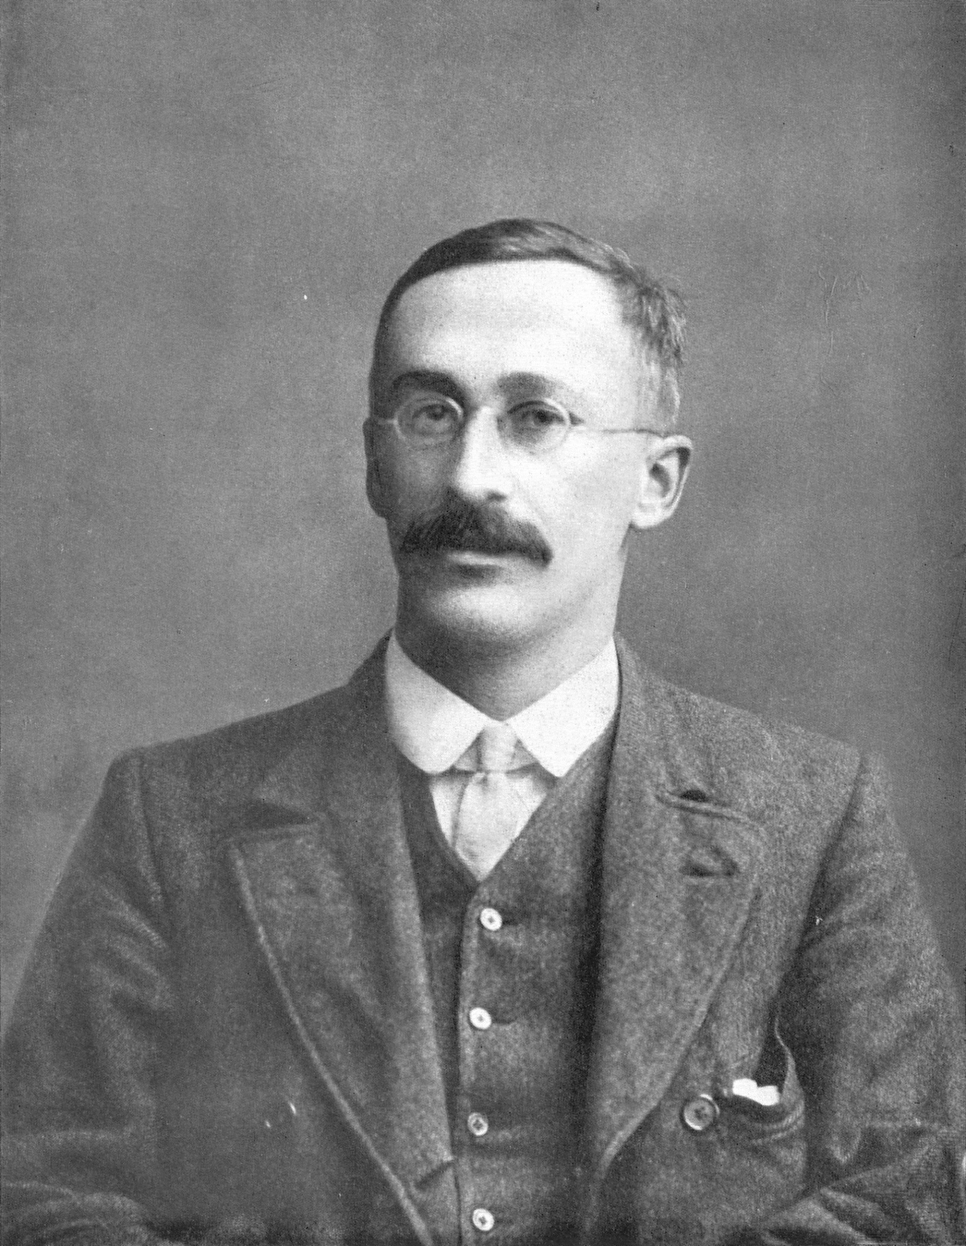
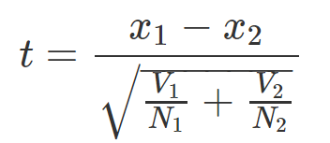
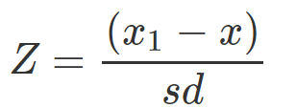
t statistic
William Sealy Gosset
Similar but not the same (z statistic)

Slide 14
T statistic
William Sealy Gosset
group 1 vs. group 2
Similar but not the same (z statistic)

Slide 15

T statistic
What happens to the t statistic as the difference between the means of two groups increase?
What happens to the t statistic as the variance increases in either group?
What happens to the t statistic as the sample size of either group increases?

Slide 16
T statistic
What happens to the t statistic as the difference between the means of two groups increase?
What happens to the t statistic as the variance increases in either group?
What happens to the t statistic as the sample size of either group increases?

Slide 17
T statistic
What happens to the t statistic as the difference between the means of two groups increase?
It depends: if x1 is larger than x2 then t will increase, if x1 is smaller than x2, then t will decrease. But importantly, t will get further away from zero in one of the two directions.
What happens to the t statistic as the variance increases in either group?
The t statistic will get closer to zero
What happens to the t statistic as the sample size of either group increases?
The t statistic will get closer to zero.

Slide 18
T-statistic to p-value
So how do you go from a t-statistic to an inference about whether a hypothesis is correct?
This is where things get (more) philosophical.

Slide 19
Is it possible to judge hypotheses based solely on how likely or unlikely an observation would be if those hypotheses were true? – Clayton 2018 Bernouilli’s fallacy

Slide 20
P-value and t-statistic
P-values are calculated from t-statistics
P-value conceptually: probability that the groups would be this different from one another if it was true that they were not from the same population

Slide 21
Probability distributions
A probability distribution is a list of all possible outcomes and their corresponding probabilities.
What’s the probability distribution of a coin toss?

Slide 22
Probability distributions
“A probability distribution is a list of all possible outcomes and their corresponding probabilities.”
(Kruschke 2011: 30 Doing Bayesian Data Analysis)
What’s the probability distribution of a coin toss?
p and 1 – p
If its fair its just 0.5 and 0.5

Slide 23
Probability distributions
Probability mass: when we are talking about discrete outcomes.
Probability density: when we are talking about continuous outcomes.
There’s a conceptual difference here: its easy to talk about the probability of specific outcomes which are discrete … but this isn’t true when the values are on a continuum.

Slide 24
Probability distributions
What’s the probability that you will consume exactly 2000.00000…. calories?
Pretty much zero.
What’s the probability that a vowel will be exactly 80.00000…. milliseconds long
Pretty much zero.
Instead, we talk about intervals (e.g. probability of 2000 or higher, probability of vowel being between 70 and 90 milliseconds).

Slide 25
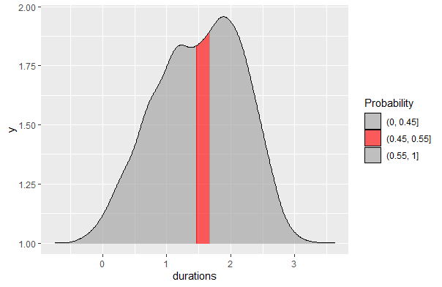
Interval probabilities
What does an interval probability look like?
Word lengths – what is the probability of being 1.45 to 1.66 seconds long.

Slide 26
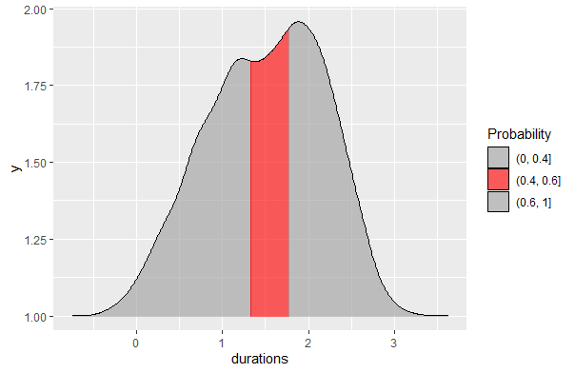
Interval probabilities
What does an interval probability look like?
Word lengths – what is the probability of being 1.32 to 1.76

Slide 27
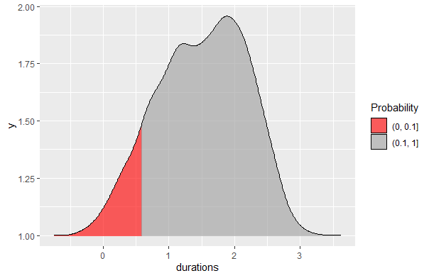
Interval probabilities
What does an interval probability look like?
Word lengths – what is the probability of being 0.587 or lower

Slide 28
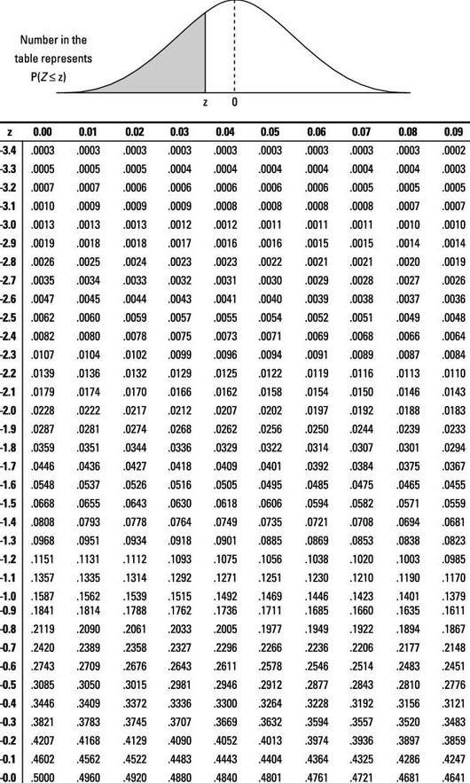
P-values
You calculate p values from the t statistic.
And you used to have to look up the results on a chart like this.

Slide 29
P-value
What is a p-value?
How is it calculated?
Why is it calculated this way?

Slide 30
P-value
What is a p-value?
Its an interval probability in relation to a hypothetical distribution that imagines you performed an experiment forever (or gathered data forever).
How is it calculated?
You need a t statistic (z statistic) and a probability distribution (a t distribution if you are doing a t test) -imaginary hypothetical distribution of values we assume if there was no difference between your groups or no relationship between your variables.
Why is it calculated this way?
There’s a complicated historical reason for this - but basically you are calculating the probability of your data given a null hypothesis.
You are not doing the more intuitive thing of calculating the probability of your hypothesis given your data.

Slide 31
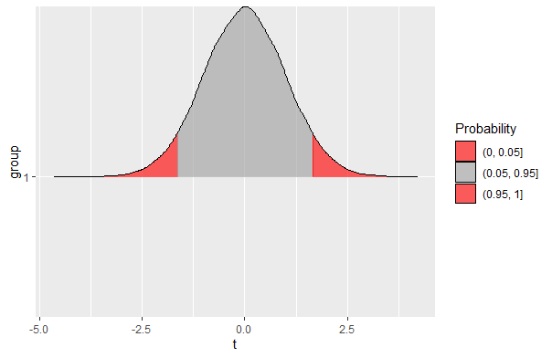
P-value
Imagine running the test for t over and over again – you would get a distribution of t statistics
The p-value is a calculation of how likely that t statistic is according to that distribution (called the t distribution)

Slide 32
P values
A p-value is the probability of receiving a specific statistic (T statistic, F statistic, R-squared) in relation to a hypothetical sampling distribution.
You can calculate the p-value from the T/F etc. statistic.
The decision to use a given alpha level (e.g. 0.05) is arbitrary.
Often, the decision to use one statistic depends on properties of your data (are they continuous, how large is your sample size, are the groups of equal size) – sometimes its just arbitrary though.

Slide 33
P values
Type 1 error: you reject the null hypothesis when its true (false positive).
Type 2 error: you accept the null hypothesis when its false (false negative).

Slide 34
Type II Error & Power
Failing to reject the null hypothesis when its false
E.g. you get a p-value below significance level, and you think your study doesn’t support the alternative hypothesis
Power of a test: the probability of not making a Type II Error
(there’s a thing called Power analysis, which asks how larger your sample has to be to detect a particular effect)

Slide 35
Type II Error & Power
What affects Power?
Significance/alpha level (lower level = less power)
Sample size (larger sample = more power)
Sample size (larger sample = more power)
Variability (less variability = more power)
Magnitude of the effect (larger magnitude = more power)

Slide 36
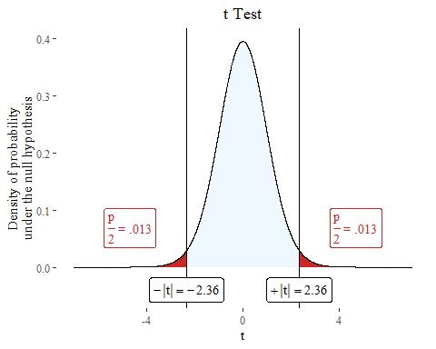
set.seed(1234) n <- 30 vowel.durations <- rnorm(n, mean = 80, sd=10) h1 <- c("strong","weak") h1 <- sample(h1, n, replace=TRUE, prob=c(0.5, 0.5)) h2 <- c("strong","weak") h2 <- sample(h2, n, replace=TRUE, prob=c(0.5, 0.5)) h3 <- c("strong","weak") h3 <- sample(h3, n, replace=TRUE, prob=c(0.5, 0.5)) h4 <- c("strong","weak") h4 <- sample(h4, n, replace=TRUE, prob=c(0.5, 0.5)) h5 <- c("strong","weak") h5 <- sample(h5, n, replace=TRUE, prob=c(0.5, 0.5)) h6 <- c("strong","weak") h6 <- sample(h6, n, replace=TRUE, prob=c(0.5, 0.5)) df <- data.frame(vowel.durations, h1,h2,h3,h4,h5,h6)
plotttest(t.test(vowel.durations~h4, data=df))

Slide 37
Type I Error & Sensitivity
Type I Error: Rejection of a true null hypothesis
Sensitivity: The probability of not making a Type I Error

Slide 38
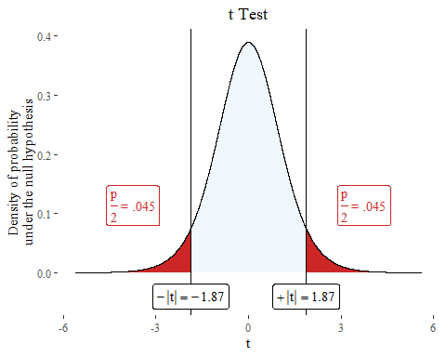
set.seed(123) n <- 6 strong.vowels <- rnorm(n, mean = 85, sd = 10) weak.vowels <- rnorm(n, mean = 80, sd = 10) strong <- rep("yes", times =n, length.out=n) weak <- rep("no", times =n, length.out=n) vowel.durations <- list.append(strong.vowels, weak.vowels) prominence <- list.append(strong, weak) t <- (mean(strong.vowels) - mean(weak.vowels)) / (sqrt((var(strong.vowels)/n) + (var(weak.vowels)/n))) t
## [1] 1.873338
plotttest(t.test(vowel.durations~prominence), tails = "one")

Slide 39
Trying and trying again or p-hacking
If we have enough variables we will eventually find a significant correlation.
If we sample more from the population we will eventually get a significant value.
If we do multiple comparisons we should adjust the p value downwards
In principle (although hard to follow in practice), use of p values should involve a stopping rule stated prior to the study, because if you gather enough data you will always eventually get a significant result.

Slide 40
Confidence interval
“A confidence interval shows the likely range in which the mean would fall if the sampling exercise were to be repeated” (Crawley 2015:61)
The interval gets wider as the unreliability goes up.

Slide 41
Confidence interval
If I say that between 35-40% of people will vote for Joe Biden in a 95% confidence interval it means
Under repeated sampling in identical conditions, the true value would be between 35-40%, 95% of the time.

Slide 42
Confidence interval
What does it mean if the confidence interval is large?
What does it mean if it straddles 0?

Slide 43
Confidence interval
What does it mean if the confidence interval is large?
There’s lots of uncertainty
What does it mean if it straddles 0?
We are not even sure of the direction of the relationship

Slide 44


Confidence intervals (for t test)
$$Lowerbound=\left(\overline{x_{1}}−\overline{x_{2}}\right)−t∗\sqrt{\frac{V_{1}+V_{2}}{n_{1}+n_{2}}}$$
Also called the Standard error
$$Upperbound=\left(\overline{x_{1}}+\overline{x_{2}}\right)+t∗\sqrt{\frac{V_{1}+V_{2}}{n_{1}+n_{2}}}$$

Slide 45
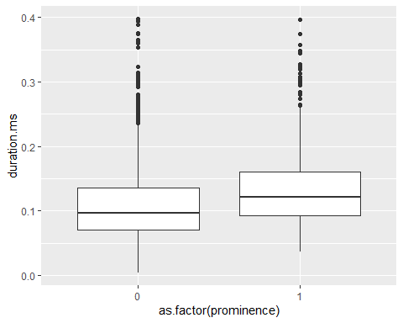
df <- read.csv("/Users/Adam/Desktop/araonavowels.csv", header=T) df <- subset(df, duration.ms <0.4) df$prominence <- ifelse(df$Stress =="y", 1,0)
boxplot <- ggplot(df, aes(as.factor(prominence), duration.ms))+ geom_boxplot() boxplot

Slide 46
ANOVA
ANOVA belongs to family of statistical techniques known as general linear models.
You are comparing the variances between two groups in relation to the variance of the groups combined.

Slide 47
ANOVA
Simulate some values according to a linear relationship / model.
set.seed(1) school <- sample(c("good", "bad"), size=30, replace=30) school.binary <- ifelse(school == "good", 1, 0) class.grade <- as.integer(rtruncnorm(a=0, b=100, m = 40, sd=15, n =30)) intercept <- 0 b1 <- 15 b2 <- 1 error <- rnorm(m=0, sd=10, n=30) test.score <- intercept + b1*school.binary +b2*class.grade + error test.score <- ifelse(test.score < 0, 0, test.score) test.score <- ifelse(test.score> 100, 100, test.score) test.score <- as.integer(test.score) data <- data.frame(test.score, school, class.grade)

Slide 48
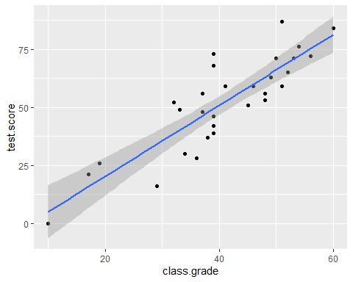
ANOVA
ggplot(data,aes(class.grade, test.score)) + geom_point()+ geom_smooth(method='lm')

Slide 49
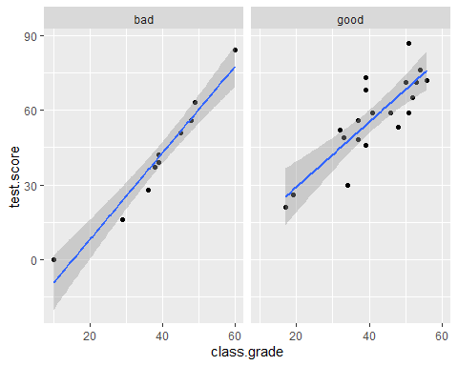
ANOVA
ggplot(data,aes(class.grade, test.score)) + geom_point()+ geom_smooth(method='lm')+ facet_wrap(~school)

Slide 50
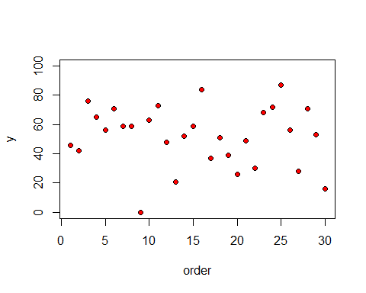
plot(1:30,test.score,ylim=c(0,100),ylab="y",xlab="order",pch=21,bg="red")

Slide 51
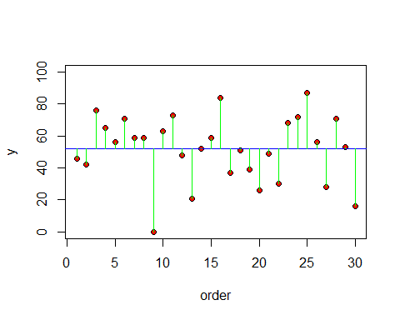

plot(1:30,test.score,ylim=c(0,100),ylab="y",xlab="order",pch=21,bg="red") abline(h=mean(test.score),col="blue") for(i in 1:100) lines(c(i,i),c(mean(test.score),test.score[i]),col="green")
$$SSY=\sum{{\left(y−\overline{y}\right)}^{2}}$$
Total sum squares = SSY
The sum of all the lengths of all the green lines.

Slide 52
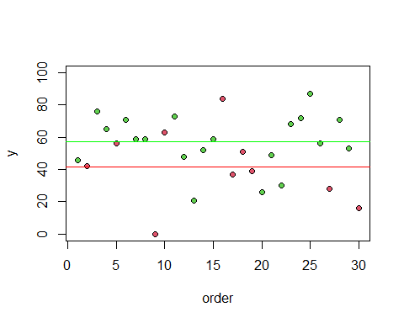
plot(1:30,test.score,ylim=c(0,100),ylab="y",xlab="order", pch=21,bg= as.numeric(as.factor(school))+1 ) abline(h=mean(test.score[school=="good"]),col="green") abline(h=mean(test.score[school=="bad"]), col="red")

Slide 53
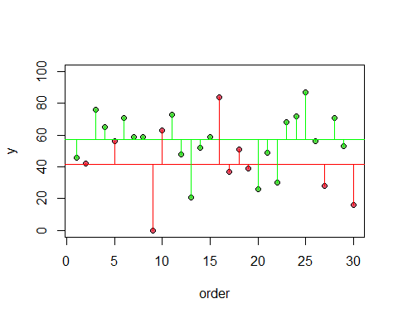

$$SSE=\sum{{\left(y−{\overline{y}}_{1}\right)}^{2}}+\sum{{\left(y−{\overline{y}}_{2}\right)}^{2}}$$
$$SSY=SSG+SSE$$

Slide 54
SSEgood <- sum((test.score[school=="good"]-mean(test.score[school=="good"]))^2) SSEbad <- sum((test.score[school=="bad"]-mean(test.score[school=="bad"]))^2) SSE = SSEgood + SSEbad
SSG = SSY - SSE

